Slide 1

FACELOOK
--Facial Emotion Recognition System

Slide 2


Team Member ( Group 13 )
01
WU JUNXIAN A0231293L
02
YING ZHUOZUO A0231534N
03
WANG KEDI A0231356L
04
ZONG JIULIN A0231352U

Slide 3


Presentation Contents
Background & Object
Tools & Technology
Design & Model
Expression Recognition
System Performance
Micro-Expression
Recognition
Findings & Future Work

Slide 4

Background & Object

Slide 5
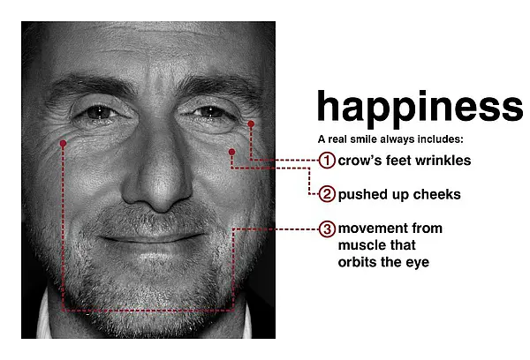
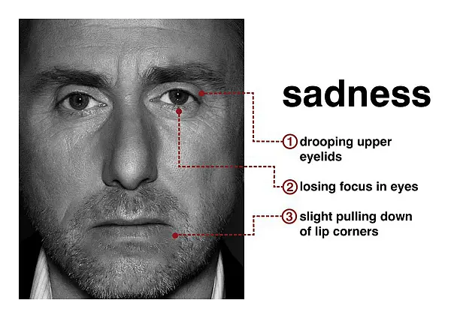
Background & Object
Facial expression is one of the most crucial way to transfer emotional information and coordinate interpersonal relationships within all kinds of emotional expressions.
Facial expression recognition refers to the selection of facial expression states from static photos or video sequences to recognize people’s emotional and psychological changes.

Slide 6
Background & Object
But sometimes expressions can be misleading. Humans are masters at hiding emotions. For social or psychological considerations, people will control their expressions.
So we need micro-expression. The concept of micro-expression was first proposed by Haggard and Isaacs in 1966. Unlike "traditional" facial expressions which can be consciously controlled, micro-expression is caused by psychological inhibition of unconscious contraction of lower muscles. The micro-expression has the characteristics of short duration (1/25 to 1/5s) and low action intensity, so it is difficult for humans to capture such information (recognition accuracy rate only 40%). But it is crucial that it can be used for lying detection, providing compelling evidence of lies. It can also be used in the treatment process by psychologists to accurately grasp a patient's emotions to make a better diagnosis.

Slide 7
Background & Object
Our objective is to recognize facial expression and micro-expression on videos and images.
For facial expression, we construct an emotion recognition model according to the training data. Predict selected test data and identify the state of the face from seven emotions.
['happy', 'angry', 'disgusted', 'neutral', 'fearful', 'sad', 'surprised’]
For micro-expression, we extract features of the frame of a video and classify micro-expression from four categories.
[‘disgust’, ‘happiness’, ‘repression’, ‘surprise’]

Slide 8

01
FaceLook
Design
Expression Recognition
02
Micro-Expression Recognition

Slide 9


Expression Recognition

Slide 10
Tools & Technology
Tools
Paddlex
Paddleclas
Paddledetection
albumentations
EasyDL
Facial expressions play an important role in emotion recognition and are used to recognize people in non-verbal communication. They are very important in daily emotional communication, second only to tone. They are also indicators of emotion, allowing a person to express an emotional state. People can immediately recognize a person’s emotional state. Therefore, information about facial expressions is usually used in automatic systems for emotion recognition.
The human face is the most exposed part of the body, allowing the use of computer vision systems to analyze facial images to identify emotions. Changes in lighting conditions and head position are the main factors that affect the quality of emotion recognition systems that use cameras. Methods based on two-dimensional image analysis are particularly sensitive to these factors. The method of realizing a three-dimensional face model is more promising.
Notes:
[1] Wang, B. (2021). [Machine Learning] Experimental notes - emotion recognition. Retrieved 28 August 2021, from https://blog.csdn.net/walilk/article/details/58709611[2] Tarnowski, P., Kołodziej, M., Majkowski, A., & Rak, R. J. (2017). Emotion recognition using facial expressions. Procedia Computer Science, 108, 1175-1184.

Slide 11
Tools & Technology
Front-end Tools
PyQt5
MediaPipe
Facial expressions play an important role in emotion recognition and are used to recognize people in non-verbal communication. They are very important in daily emotional communication, second only to tone. They are also indicators of emotion, allowing a person to express an emotional state. People can immediately recognize a person’s emotional state. Therefore, information about facial expressions is usually used in automatic systems for emotion recognition.
The human face is the most exposed part of the body, allowing the use of computer vision systems to analyze facial images to identify emotions. Changes in lighting conditions and head position are the main factors that affect the quality of emotion recognition systems that use cameras. Methods based on two-dimensional image analysis are particularly sensitive to these factors. The method of realizing a three-dimensional face model is more promising.
Notes:
[1] Wang, B. (2021). [Machine Learning] Experimental notes - emotion recognition. Retrieved 28 August 2021, from https://blog.csdn.net/walilk/article/details/58709611[2] Tarnowski, P., Kołodziej, M., Majkowski, A., & Rak, R. J. (2017). Emotion recognition using facial expressions. Procedia Computer Science, 108, 1175-1184.

Slide 12
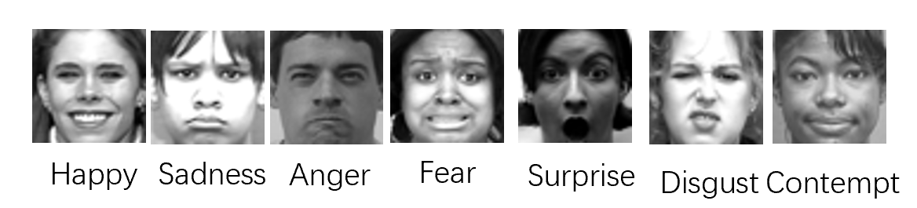
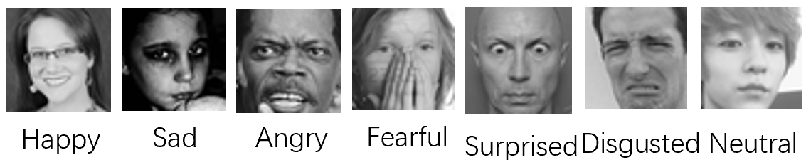
Design & Model
Datasets
CK+48
XunFei facial expression competition
Facial expressions play an important role in emotion recognition and are used to recognize people in non-verbal communication. They are very important in daily emotional communication, second only to tone. They are also indicators of emotion, allowing a person to express an emotional state. People can immediately recognize a person’s emotional state. Therefore, information about facial expressions is usually used in automatic systems for emotion recognition.
The human face is the most exposed part of the body, allowing the use of computer vision systems to analyze facial images to identify emotions. Changes in lighting conditions and head position are the main factors that affect the quality of emotion recognition systems that use cameras. Methods based on two-dimensional image analysis are particularly sensitive to these factors. The method of realizing a three-dimensional face model is more promising.
Notes:
[1] Wang, B. (2021). [Machine Learning] Experimental notes - emotion recognition. Retrieved 28 August 2021, from https://blog.csdn.net/walilk/article/details/58709611[2] Tarnowski, P., Kołodziej, M., Majkowski, A., & Rak, R. J. (2017). Emotion recognition using facial expressions. Procedia Computer Science, 108, 1175-1184.

Slide 13
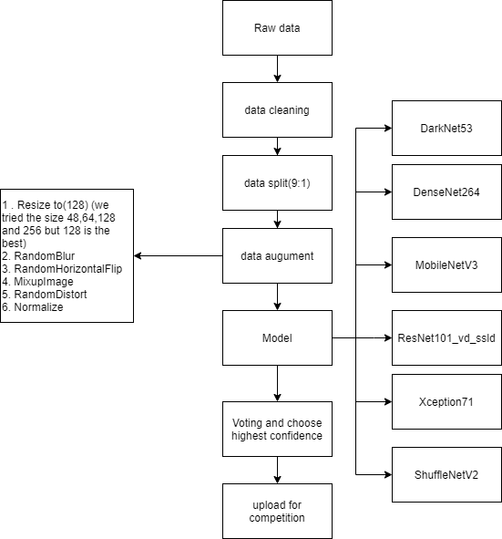
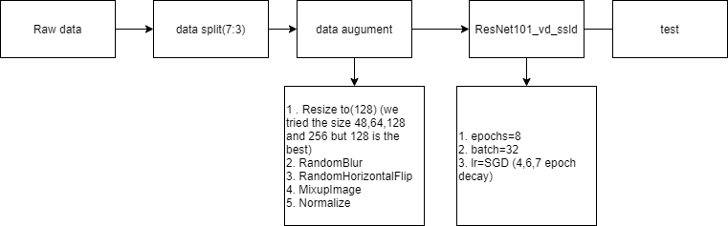
Design & Model
Model
PaddleX pipeline
xunfei emotion data set
CK+48 dataset:
Facial expressions play an important role in emotion recognition and are used to recognize people in non-verbal communication. They are very important in daily emotional communication, second only to tone. They are also indicators of emotion, allowing a person to express an emotional state. People can immediately recognize a person’s emotional state. Therefore, information about facial expressions is usually used in automatic systems for emotion recognition.
The human face is the most exposed part of the body, allowing the use of computer vision systems to analyze facial images to identify emotions. Changes in lighting conditions and head position are the main factors that affect the quality of emotion recognition systems that use cameras. Methods based on two-dimensional image analysis are particularly sensitive to these factors. The method of realizing a three-dimensional face model is more promising.
Notes:
[1] Wang, B. (2021). [Machine Learning] Experimental notes - emotion recognition. Retrieved 28 August 2021, from https://blog.csdn.net/walilk/article/details/58709611[2] Tarnowski, P., Kołodziej, M., Majkowski, A., & Rak, R. J. (2017). Emotion recognition using facial expressions. Procedia Computer Science, 108, 1175-1184.

Slide 14
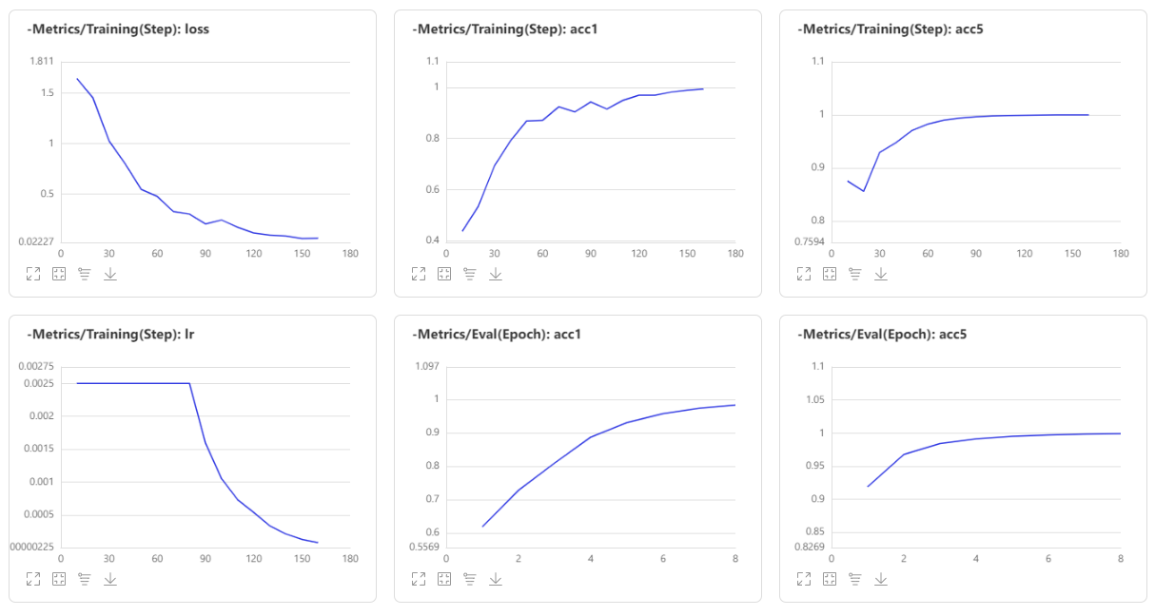

System Performance
Xunfei Competition Results
CK+48 model training
Facial expressions play an important role in emotion recognition and are used to recognize people in non-verbal communication. They are very important in daily emotional communication, second only to tone. They are also indicators of emotion, allowing a person to express an emotional state. People can immediately recognize a person’s emotional state. Therefore, information about facial expressions is usually used in automatic systems for emotion recognition.
The human face is the most exposed part of the body, allowing the use of computer vision systems to analyze facial images to identify emotions. Changes in lighting conditions and head position are the main factors that affect the quality of emotion recognition systems that use cameras. Methods based on two-dimensional image analysis are particularly sensitive to these factors. The method of realizing a three-dimensional face model is more promising.
Notes:
[1] Wang, B. (2021). [Machine Learning] Experimental notes - emotion recognition. Retrieved 28 August 2021, from https://blog.csdn.net/walilk/article/details/58709611[2] Tarnowski, P., Kołodziej, M., Majkowski, A., & Rak, R. J. (2017). Emotion recognition using facial expressions. Procedia Computer Science, 108, 1175-1184.

Slide 15
System Performance
XunFei model training
ImageNet pre-trained model information
Model | Top-1 Acc | Top-5 Acc | SD855 time(ms) bs=1 | Flops(G) | Params(M) | Model storage size(M)
MobileNetV3_large | 0.7896 | 0.9448 | 19.30835 | 0.45 | 5.47 | 21
ShuffleNetV2 | 0.7315 | 0.912 | 34.770149 | 1.12 | 7.32 | 28
ResNet101_vd | 0.8373 | 0.9669 | 6.11704 | 13.76222 | 16.1 | 44.57
DarkNet53 | 0.78 | 0.941 | 4.10829 | 12.1714 | 18.58 | 41.6
DenseNet264 | 0.7796 | 0.9385 | 12.14722 | 26.27707 | 11.54 | 33.37
Xception71 | 0.8111 | 0.9545 | 8.72457 | 31.55549 | 31.77 | 37.28
Facial expressions play an important role in emotion recognition and are used to recognize people in non-verbal communication. They are very important in daily emotional communication, second only to tone. They are also indicators of emotion, allowing a person to express an emotional state. People can immediately recognize a person’s emotional state. Therefore, information about facial expressions is usually used in automatic systems for emotion recognition.
The human face is the most exposed part of the body, allowing the use of computer vision systems to analyze facial images to identify emotions. Changes in lighting conditions and head position are the main factors that affect the quality of emotion recognition systems that use cameras. Methods based on two-dimensional image analysis are particularly sensitive to these factors. The method of realizing a three-dimensional face model is more promising.
Notes:
[1] Wang, B. (2021). [Machine Learning] Experimental notes - emotion recognition. Retrieved 28 August 2021, from https://blog.csdn.net/walilk/article/details/58709611[2] Tarnowski, P., Kołodziej, M., Majkowski, A., & Rak, R. J. (2017). Emotion recognition using facial expressions. Procedia Computer Science, 108, 1175-1184.

Slide 16
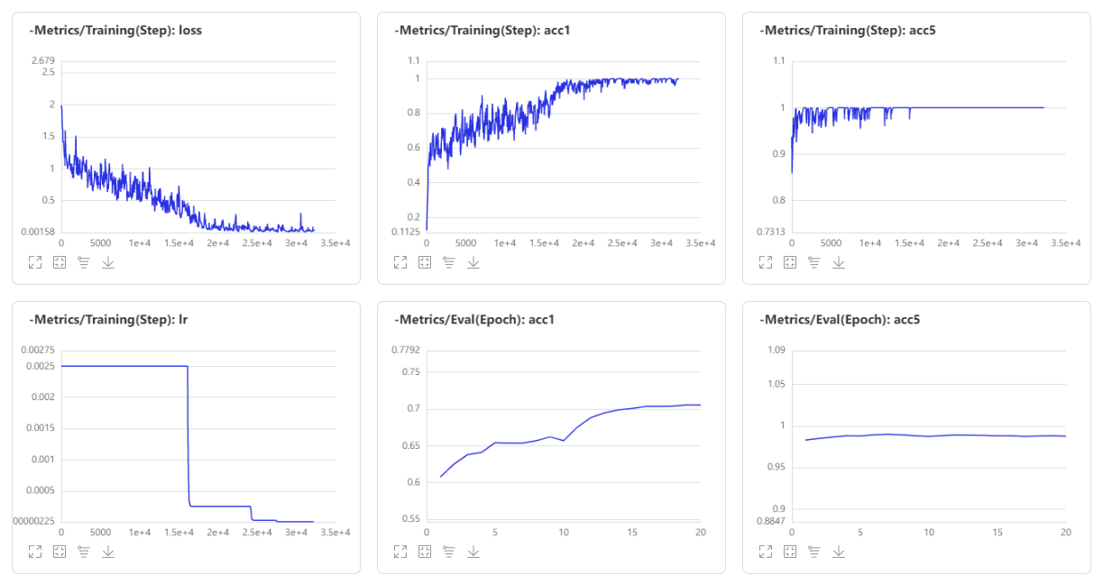
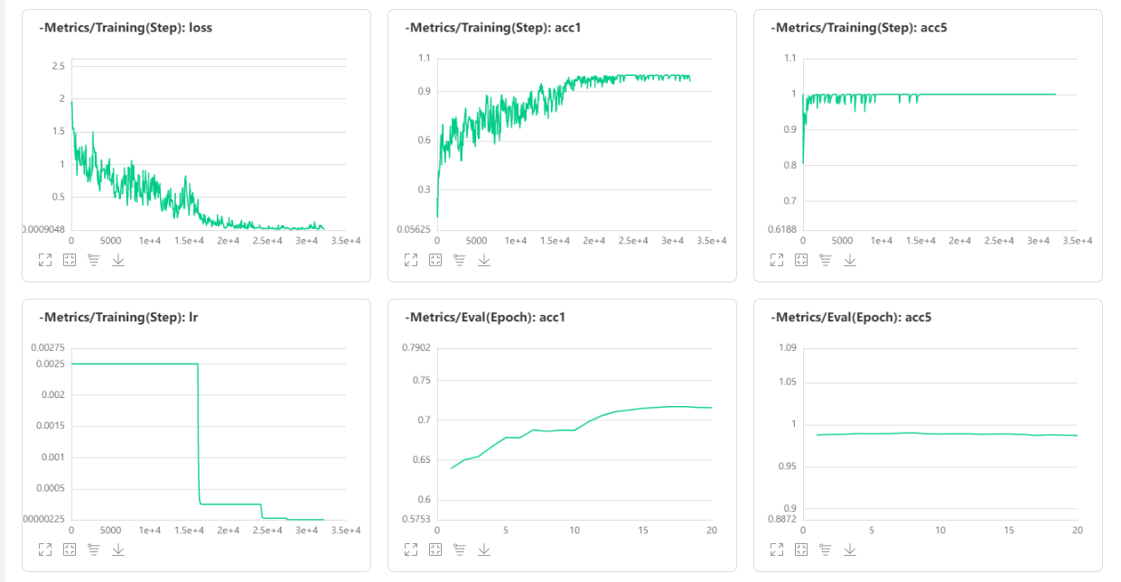
System Performance
DarkNet53
DenseNet264
Facial expressions play an important role in emotion recognition and are used to recognize people in non-verbal communication. They are very important in daily emotional communication, second only to tone. They are also indicators of emotion, allowing a person to express an emotional state. People can immediately recognize a person’s emotional state. Therefore, information about facial expressions is usually used in automatic systems for emotion recognition.
The human face is the most exposed part of the body, allowing the use of computer vision systems to analyze facial images to identify emotions. Changes in lighting conditions and head position are the main factors that affect the quality of emotion recognition systems that use cameras. Methods based on two-dimensional image analysis are particularly sensitive to these factors. The method of realizing a three-dimensional face model is more promising.
Notes:
[1] Wang, B. (2021). [Machine Learning] Experimental notes - emotion recognition. Retrieved 28 August 2021, from https://blog.csdn.net/walilk/article/details/58709611[2] Tarnowski, P., Kołodziej, M., Majkowski, A., & Rak, R. J. (2017). Emotion recognition using facial expressions. Procedia Computer Science, 108, 1175-1184.

Slide 17
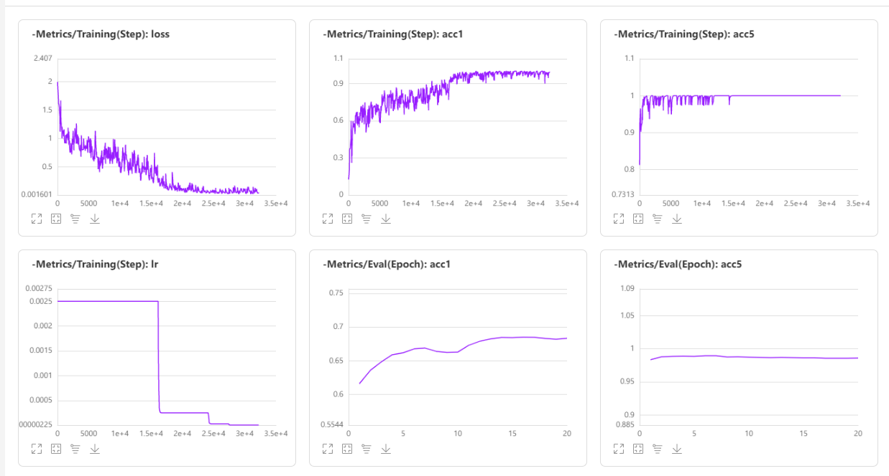
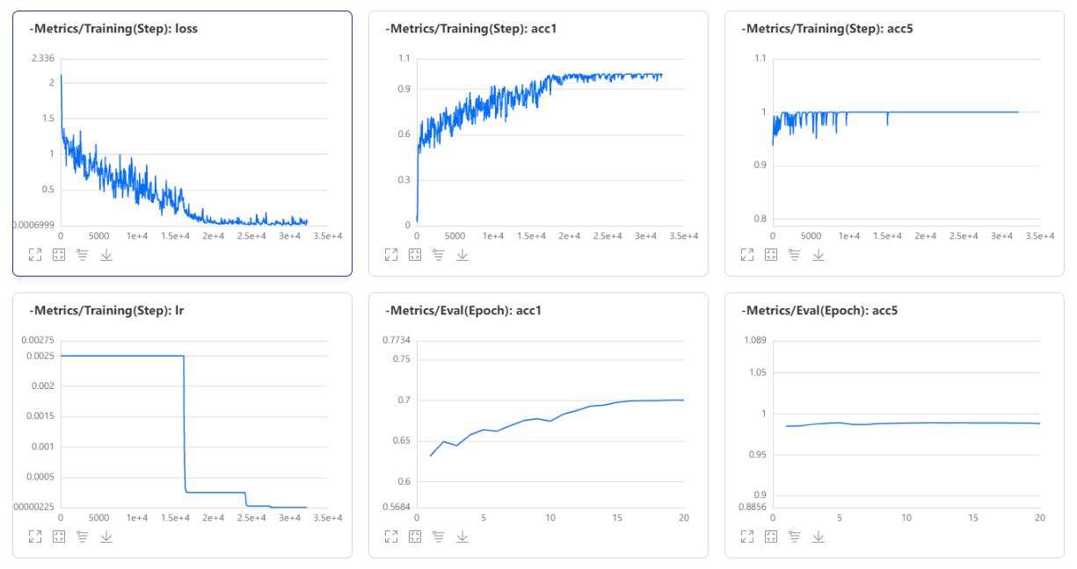
System Performance
MobileNetv3
ResNetv101_vd_ssld
Facial expressions play an important role in emotion recognition and are used to recognize people in non-verbal communication. They are very important in daily emotional communication, second only to tone. They are also indicators of emotion, allowing a person to express an emotional state. People can immediately recognize a person’s emotional state. Therefore, information about facial expressions is usually used in automatic systems for emotion recognition.
The human face is the most exposed part of the body, allowing the use of computer vision systems to analyze facial images to identify emotions. Changes in lighting conditions and head position are the main factors that affect the quality of emotion recognition systems that use cameras. Methods based on two-dimensional image analysis are particularly sensitive to these factors. The method of realizing a three-dimensional face model is more promising.
Notes:
[1] Wang, B. (2021). [Machine Learning] Experimental notes - emotion recognition. Retrieved 28 August 2021, from https://blog.csdn.net/walilk/article/details/58709611[2] Tarnowski, P., Kołodziej, M., Majkowski, A., & Rak, R. J. (2017). Emotion recognition using facial expressions. Procedia Computer Science, 108, 1175-1184.

Slide 18
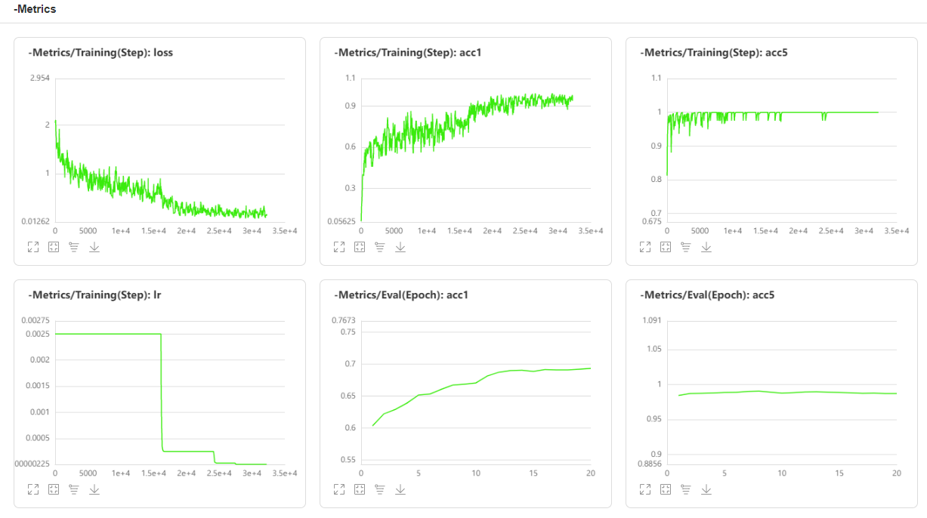
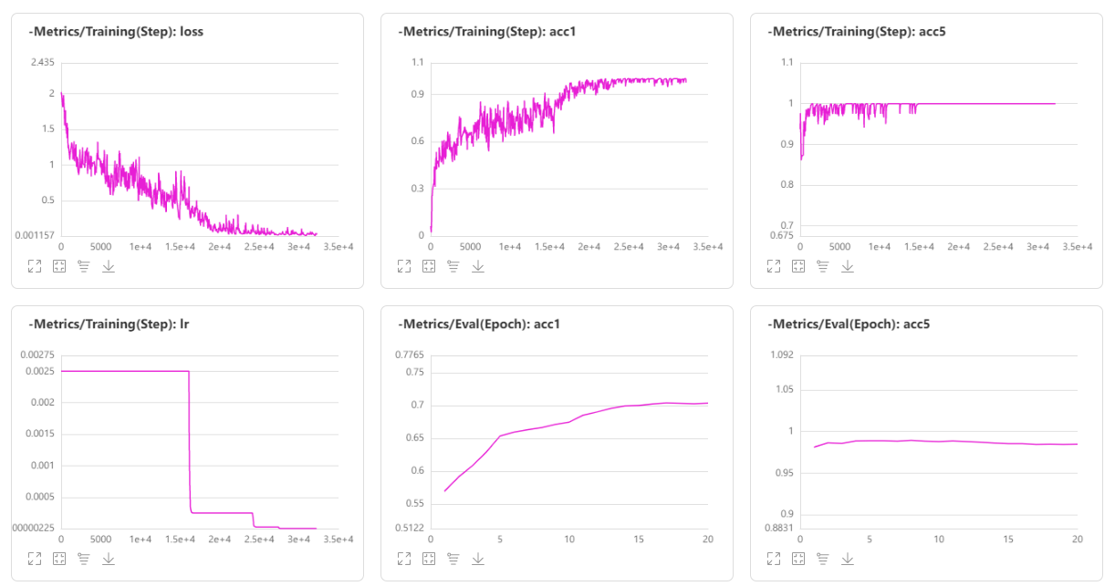
System Performance
ShuffleNetv2
Xception71
Facial expressions play an important role in emotion recognition and are used to recognize people in non-verbal communication. They are very important in daily emotional communication, second only to tone. They are also indicators of emotion, allowing a person to express an emotional state. People can immediately recognize a person’s emotional state. Therefore, information about facial expressions is usually used in automatic systems for emotion recognition.
The human face is the most exposed part of the body, allowing the use of computer vision systems to analyze facial images to identify emotions. Changes in lighting conditions and head position are the main factors that affect the quality of emotion recognition systems that use cameras. Methods based on two-dimensional image analysis are particularly sensitive to these factors. The method of realizing a three-dimensional face model is more promising.
Notes:
[1] Wang, B. (2021). [Machine Learning] Experimental notes - emotion recognition. Retrieved 28 August 2021, from https://blog.csdn.net/walilk/article/details/58709611[2] Tarnowski, P., Kołodziej, M., Majkowski, A., & Rak, R. J. (2017). Emotion recognition using facial expressions. Procedia Computer Science, 108, 1175-1184.

Slide 19
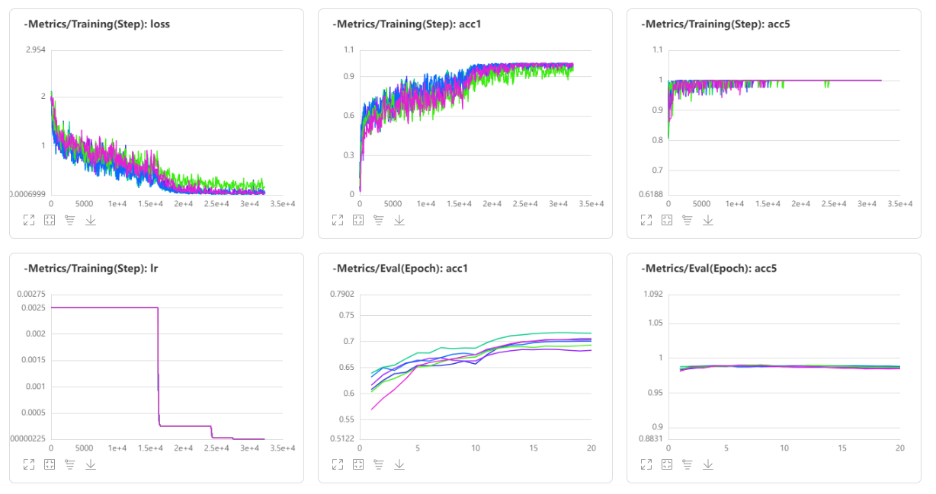
System Performance
Comparison
Facial expressions play an important role in emotion recognition and are used to recognize people in non-verbal communication. They are very important in daily emotional communication, second only to tone. They are also indicators of emotion, allowing a person to express an emotional state. People can immediately recognize a person’s emotional state. Therefore, information about facial expressions is usually used in automatic systems for emotion recognition.
The human face is the most exposed part of the body, allowing the use of computer vision systems to analyze facial images to identify emotions. Changes in lighting conditions and head position are the main factors that affect the quality of emotion recognition systems that use cameras. Methods based on two-dimensional image analysis are particularly sensitive to these factors. The method of realizing a three-dimensional face model is more promising.
Notes:
[1] Wang, B. (2021). [Machine Learning] Experimental notes - emotion recognition. Retrieved 28 August 2021, from https://blog.csdn.net/walilk/article/details/58709611[2] Tarnowski, P., Kołodziej, M., Majkowski, A., & Rak, R. J. (2017). Emotion recognition using facial expressions. Procedia Computer Science, 108, 1175-1184.

Slide 20


Micro-Expression Recognition

Slide 21
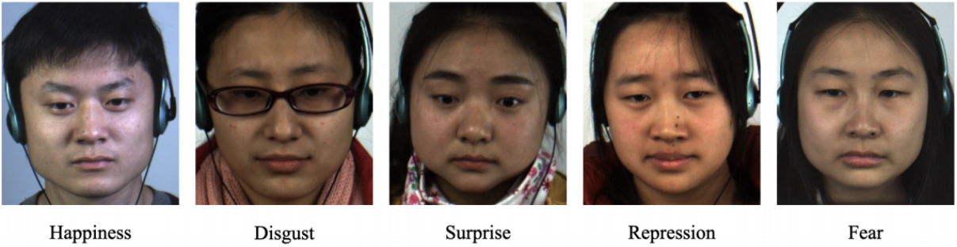
Design & Model
Datasets
Cleaning
CASME II
Eliminate two unlabeled samples
Eliminate types that have too few samples(Label : "fear" & Label: “sadness” ), and types that cannot be classified(Label : "Others")
In the end we are left with 150 samples in four categories
Facial expressions play an important role in emotion recognition and are used to recognize people in non-verbal communication. They are very important in daily emotional communication, second only to tone. They are also indicators of emotion, allowing a person to express an emotional state. People can immediately recognize a person’s emotional state. Therefore, information about facial expressions is usually used in automatic systems for emotion recognition.
The human face is the most exposed part of the body, allowing the use of computer vision systems to analyze facial images to identify emotions. Changes in lighting conditions and head position are the main factors that affect the quality of emotion recognition systems that use cameras. Methods based on two-dimensional image analysis are particularly sensitive to these factors. The method of realizing a three-dimensional face model is more promising.
Notes:
[1] Wang, B. (2021). [Machine Learning] Experimental notes - emotion recognition. Retrieved 28 August 2021, from https://blog.csdn.net/walilk/article/details/58709611[2] Tarnowski, P., Kołodziej, M., Majkowski, A., & Rak, R. J. (2017). Emotion recognition using facial expressions. Procedia Computer Science, 108, 1175-1184.

Slide 22
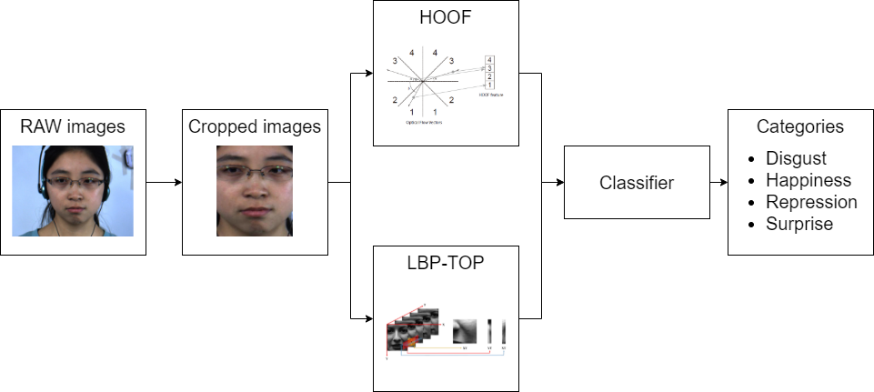
Design
Facial expressions play an important role in emotion recognition and are used to recognize people in non-verbal communication. They are very important in daily emotional communication, second only to tone. They are also indicators of emotion, allowing a person to express an emotional state. People can immediately recognize a person’s emotional state. Therefore, information about facial expressions is usually used in automatic systems for emotion recognition.
The human face is the most exposed part of the body, allowing the use of computer vision systems to analyze facial images to identify emotions. Changes in lighting conditions and head position are the main factors that affect the quality of emotion recognition systems that use cameras. Methods based on two-dimensional image analysis are particularly sensitive to these factors. The method of realizing a three-dimensional face model is more promising.
Notes:
[1] Wang, B. (2021). [Machine Learning] Experimental notes - emotion recognition. Retrieved 28 August 2021, from https://blog.csdn.net/walilk/article/details/58709611[2] Tarnowski, P., Kołodziej, M., Majkowski, A., & Rak, R. J. (2017). Emotion recognition using facial expressions. Procedia Computer Science, 108, 1175-1184.

Slide 23
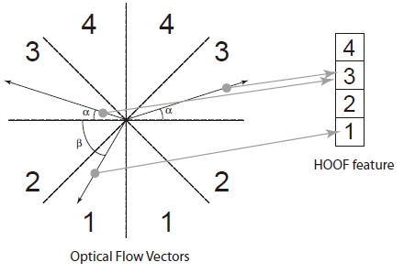
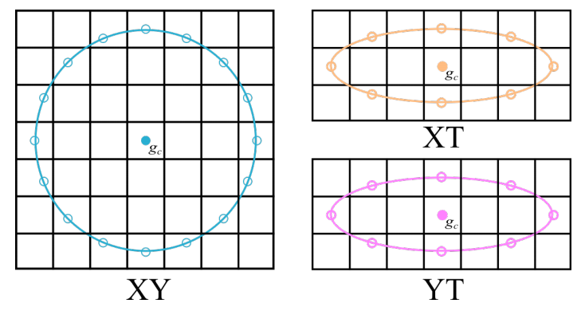
Features Extraction
HOOF
LBP-TOP
Facial expressions play an important role in emotion recognition and are used to recognize people in non-verbal communication. They are very important in daily emotional communication, second only to tone. They are also indicators of emotion, allowing a person to express an emotional state. People can immediately recognize a person’s emotional state. Therefore, information about facial expressions is usually used in automatic systems for emotion recognition.
The human face is the most exposed part of the body, allowing the use of computer vision systems to analyze facial images to identify emotions. Changes in lighting conditions and head position are the main factors that affect the quality of emotion recognition systems that use cameras. Methods based on two-dimensional image analysis are particularly sensitive to these factors. The method of realizing a three-dimensional face model is more promising.
Notes:
[1] Wang, B. (2021). [Machine Learning] Experimental notes - emotion recognition. Retrieved 28 August 2021, from https://blog.csdn.net/walilk/article/details/58709611[2] Tarnowski, P., Kołodziej, M., Majkowski, A., & Rak, R. J. (2017). Emotion recognition using facial expressions. Procedia Computer Science, 108, 1175-1184.

Slide 24
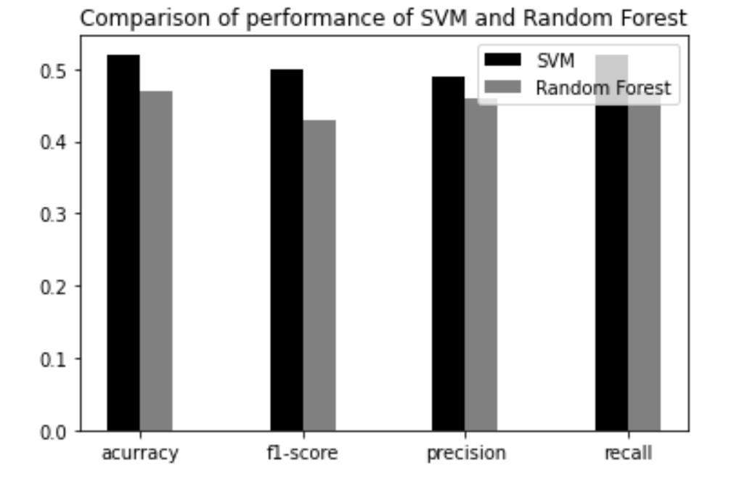
Classifier comparison
Facial expressions play an important role in emotion recognition and are used to recognize people in non-verbal communication. They are very important in daily emotional communication, second only to tone. They are also indicators of emotion, allowing a person to express an emotional state. People can immediately recognize a person’s emotional state. Therefore, information about facial expressions is usually used in automatic systems for emotion recognition.
The human face is the most exposed part of the body, allowing the use of computer vision systems to analyze facial images to identify emotions. Changes in lighting conditions and head position are the main factors that affect the quality of emotion recognition systems that use cameras. Methods based on two-dimensional image analysis are particularly sensitive to these factors. The method of realizing a three-dimensional face model is more promising.
Notes:
[1] Wang, B. (2021). [Machine Learning] Experimental notes - emotion recognition. Retrieved 28 August 2021, from https://blog.csdn.net/walilk/article/details/58709611[2] Tarnowski, P., Kołodziej, M., Majkowski, A., & Rak, R. J. (2017). Emotion recognition using facial expressions. Procedia Computer Science, 108, 1175-1184.

Slide 25
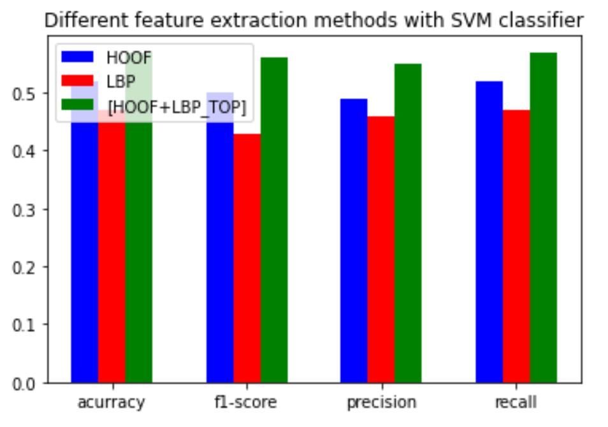
Ablation Study
Facial expressions play an important role in emotion recognition and are used to recognize people in non-verbal communication. They are very important in daily emotional communication, second only to tone. They are also indicators of emotion, allowing a person to express an emotional state. People can immediately recognize a person’s emotional state. Therefore, information about facial expressions is usually used in automatic systems for emotion recognition.
The human face is the most exposed part of the body, allowing the use of computer vision systems to analyze facial images to identify emotions. Changes in lighting conditions and head position are the main factors that affect the quality of emotion recognition systems that use cameras. Methods based on two-dimensional image analysis are particularly sensitive to these factors. The method of realizing a three-dimensional face model is more promising.
Notes:
[1] Wang, B. (2021). [Machine Learning] Experimental notes - emotion recognition. Retrieved 28 August 2021, from https://blog.csdn.net/walilk/article/details/58709611[2] Tarnowski, P., Kołodziej, M., Majkowski, A., & Rak, R. J. (2017). Emotion recognition using facial expressions. Procedia Computer Science, 108, 1175-1184.

Slide 26
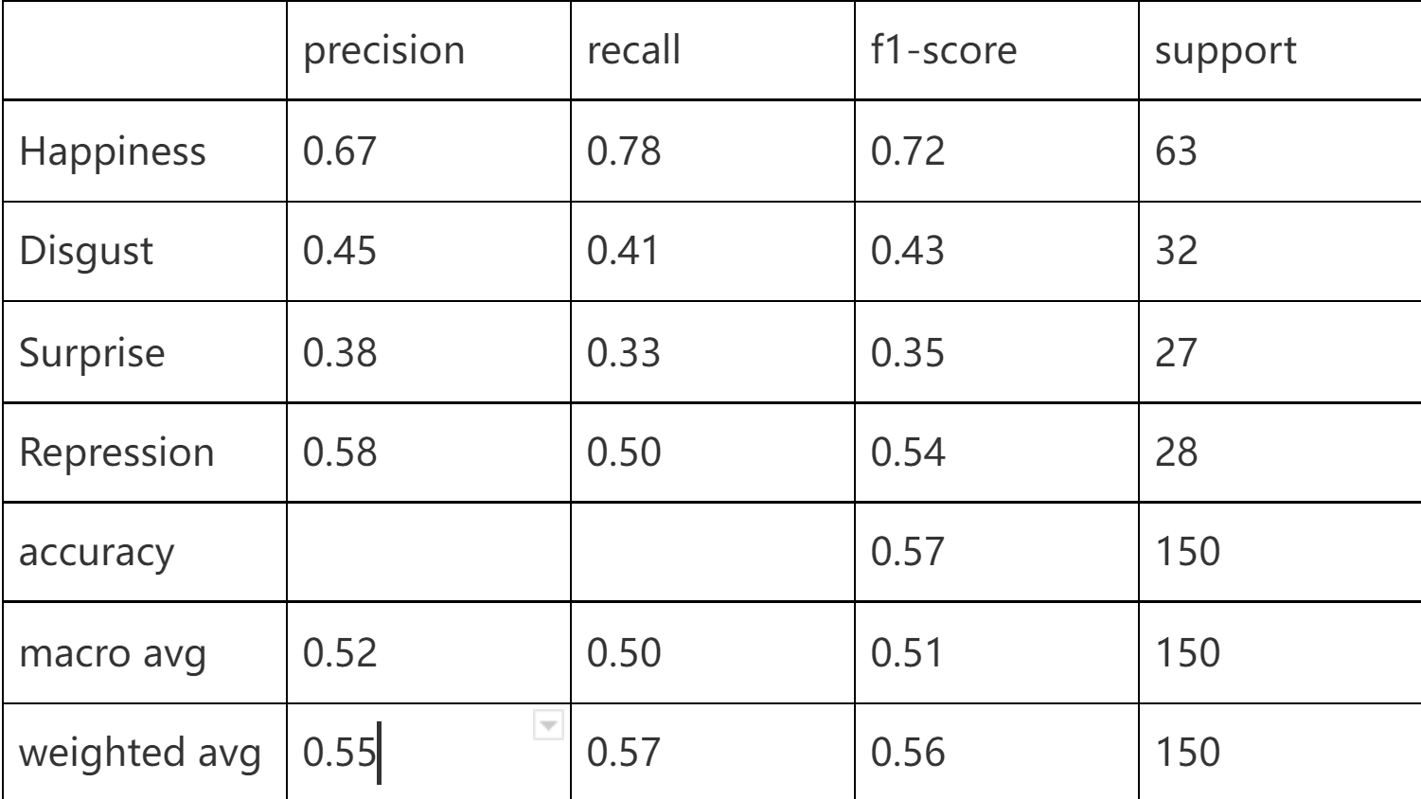
Final Performance
Classification Report
Facial expressions play an important role in emotion recognition and are used to recognize people in non-verbal communication. They are very important in daily emotional communication, second only to tone. They are also indicators of emotion, allowing a person to express an emotional state. People can immediately recognize a person’s emotional state. Therefore, information about facial expressions is usually used in automatic systems for emotion recognition.
The human face is the most exposed part of the body, allowing the use of computer vision systems to analyze facial images to identify emotions. Changes in lighting conditions and head position are the main factors that affect the quality of emotion recognition systems that use cameras. Methods based on two-dimensional image analysis are particularly sensitive to these factors. The method of realizing a three-dimensional face model is more promising.
Notes:
[1] Wang, B. (2021). [Machine Learning] Experimental notes - emotion recognition. Retrieved 28 August 2021, from https://blog.csdn.net/walilk/article/details/58709611[2] Tarnowski, P., Kołodziej, M., Majkowski, A., & Rak, R. J. (2017). Emotion recognition using facial expressions. Procedia Computer Science, 108, 1175-1184.

Slide 27
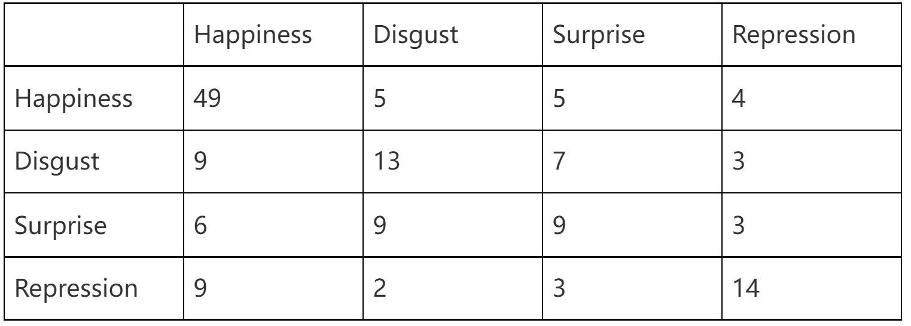
Final Performance
Confusion Matrix
Facial expressions play an important role in emotion recognition and are used to recognize people in non-verbal communication. They are very important in daily emotional communication, second only to tone. They are also indicators of emotion, allowing a person to express an emotional state. People can immediately recognize a person’s emotional state. Therefore, information about facial expressions is usually used in automatic systems for emotion recognition.
The human face is the most exposed part of the body, allowing the use of computer vision systems to analyze facial images to identify emotions. Changes in lighting conditions and head position are the main factors that affect the quality of emotion recognition systems that use cameras. Methods based on two-dimensional image analysis are particularly sensitive to these factors. The method of realizing a three-dimensional face model is more promising.
Notes:
[1] Wang, B. (2021). [Machine Learning] Experimental notes - emotion recognition. Retrieved 28 August 2021, from https://blog.csdn.net/walilk/article/details/58709611[2] Tarnowski, P., Kołodziej, M., Majkowski, A., & Rak, R. J. (2017). Emotion recognition using facial expressions. Procedia Computer Science, 108, 1175-1184.

Slide 28



Findings & Future Work

Slide 29


Findings & Discussion
Expression Recognition:
Dataset Explore
The boundary between the different facial expressions is not so clear because the emotion state is not like a math problem and it is labelled by humans.
We may counter some no-face image as dataset
It is an imbalanced dataset maybe because of the different difficulty of collecting labels. So the training is hard.
According to the heat map of data, the features of humans’ eyes and noses seem to affect the result heavily.
Angry?
Face?
Facial expressions play an important role in emotion recognition and are used to recognize people in non-verbal communication. They are very important in daily emotional communication, second only to tone. They are also indicators of emotion, allowing a person to express an emotional state. People can immediately recognize a person’s emotional state. Therefore, information about facial expressions is usually used in automatic systems for emotion recognition.
The human face is the most exposed part of the body, allowing the use of computer vision systems to analyze facial images to identify emotions. Changes in lighting conditions and head position are the main factors that affect the quality of emotion recognition systems that use cameras. Methods based on two-dimensional image analysis are particularly sensitive to these factors. The method of realizing a three-dimensional face model is more promising.
Notes:
[1] Wang, B. (2021). [Machine Learning] Experimental notes - emotion recognition. Retrieved 28 August 2021, from https://blog.csdn.net/walilk/article/details/58709611[2] Tarnowski, P., Kołodziej, M., Majkowski, A., & Rak, R. J. (2017). Emotion recognition using facial expressions. Procedia Computer Science, 108, 1175-1184.

Slide 30
Findings & Discussion
Expression Recognition:
Training Skills
data augment: according to the paper data augment, it is generally useful to use it is generally useful to use data augment to simulate the real data condition
learning rate can try with adam,adamw, sgd with momentum.
A pre-trained model or transfer learning can be useful in most cases
Vision transformer needs a large dataset to converge
Facial expressions play an important role in emotion recognition and are used to recognize people in non-verbal communication. They are very important in daily emotional communication, second only to tone. They are also indicators of emotion, allowing a person to express an emotional state. People can immediately recognize a person’s emotional state. Therefore, information about facial expressions is usually used in automatic systems for emotion recognition.
The human face is the most exposed part of the body, allowing the use of computer vision systems to analyze facial images to identify emotions. Changes in lighting conditions and head position are the main factors that affect the quality of emotion recognition systems that use cameras. Methods based on two-dimensional image analysis are particularly sensitive to these factors. The method of realizing a three-dimensional face model is more promising.
Notes:
[1] Wang, B. (2021). [Machine Learning] Experimental notes - emotion recognition. Retrieved 28 August 2021, from https://blog.csdn.net/walilk/article/details/58709611[2] Tarnowski, P., Kołodziej, M., Majkowski, A., & Rak, R. J. (2017). Emotion recognition using facial expressions. Procedia Computer Science, 108, 1175-1184.

Slide 31
Findings & Discussion
Expression Recognition:
Deployment
If it is not a competition, it is a wise idea to prune and do knowledge distillation of the model to get a faster interference.
According to the device to choose different networks by their FLOP, also the platform to deploy should be concerned.
We can deploy our heavy model on the cloud GPU server and access it with api(request). Or just deploying a light model like MobileNet on the edge device.
To deal with the real-time video recognition, it is possible to combine early/late fusion to make the results more stable.
Facial expressions play an important role in emotion recognition and are used to recognize people in non-verbal communication. They are very important in daily emotional communication, second only to tone. They are also indicators of emotion, allowing a person to express an emotional state. People can immediately recognize a person’s emotional state. Therefore, information about facial expressions is usually used in automatic systems for emotion recognition.
The human face is the most exposed part of the body, allowing the use of computer vision systems to analyze facial images to identify emotions. Changes in lighting conditions and head position are the main factors that affect the quality of emotion recognition systems that use cameras. Methods based on two-dimensional image analysis are particularly sensitive to these factors. The method of realizing a three-dimensional face model is more promising.
Notes:
[1] Wang, B. (2021). [Machine Learning] Experimental notes - emotion recognition. Retrieved 28 August 2021, from https://blog.csdn.net/walilk/article/details/58709611[2] Tarnowski, P., Kołodziej, M., Majkowski, A., & Rak, R. J. (2017). Emotion recognition using facial expressions. Procedia Computer Science, 108, 1175-1184.

Slide 32
Findings & Discussion
Micro-Expression Recognition:
Findings
In the case of small samples, the deep learning algorithm is very easy to over fit
Combining different methods together is a feasible way to get better results.
Challenge
Micro-expression recognition will be influenced heavily by background and noise.
The number of data sets is too small.
Poor real-time performance.
Facial expressions play an important role in emotion recognition and are used to recognize people in non-verbal communication. They are very important in daily emotional communication, second only to tone. They are also indicators of emotion, allowing a person to express an emotional state. People can immediately recognize a person’s emotional state. Therefore, information about facial expressions is usually used in automatic systems for emotion recognition.
The human face is the most exposed part of the body, allowing the use of computer vision systems to analyze facial images to identify emotions. Changes in lighting conditions and head position are the main factors that affect the quality of emotion recognition systems that use cameras. Methods based on two-dimensional image analysis are particularly sensitive to these factors. The method of realizing a three-dimensional face model is more promising.
Notes:
[1] Wang, B. (2021). [Machine Learning] Experimental notes - emotion recognition. Retrieved 28 August 2021, from https://blog.csdn.net/walilk/article/details/58709611[2] Tarnowski, P., Kołodziej, M., Majkowski, A., & Rak, R. J. (2017). Emotion recognition using facial expressions. Procedia Computer Science, 108, 1175-1184.

Slide 33
Application & Future Work
Application:
Combine emotion recognition models with a psychology chatbot to create a virtual psychological consultant
Use emotion recognition models to predict the feelings of participants in classes.
Analysis whether users like this product or not and which part users like best.
Future Work:
Increase the accuracy of expression recognition.
For micro-expression recognition, improve the classification accuracy under the condition of small samples.
Improve the speed of micro-expression recognition and deploy it on the user interface.
Combine expression recognition and micro-expression together to recognize human emotion.
Facial expressions play an important role in emotion recognition and are used to recognize people in non-verbal communication. They are very important in daily emotional communication, second only to tone. They are also indicators of emotion, allowing a person to express an emotional state. People can immediately recognize a person’s emotional state. Therefore, information about facial expressions is usually used in automatic systems for emotion recognition.
The human face is the most exposed part of the body, allowing the use of computer vision systems to analyze facial images to identify emotions. Changes in lighting conditions and head position are the main factors that affect the quality of emotion recognition systems that use cameras. Methods based on two-dimensional image analysis are particularly sensitive to these factors. The method of realizing a three-dimensional face model is more promising.
Notes:
[1] Wang, B. (2021). [Machine Learning] Experimental notes - emotion recognition. Retrieved 28 August 2021, from https://blog.csdn.net/walilk/article/details/58709611[2] Tarnowski, P., Kołodziej, M., Majkowski, A., & Rak, R. J. (2017). Emotion recognition using facial expressions. Procedia Computer Science, 108, 1175-1184.

Slide 34
Thank you for your attention

